Slide 1
The PBL, Part 3: KPP and TKE schemes (with Experiment #1)
ADDED Exp #1 due date to slide 65
ATM 419/563
Spring 2022
Fovell
© Copyright 2022 Robert Fovell, Univ. at Albany, SUNY, rfovell@albany.edu

Slide 2
Outline
Some Richardson numbers
Recap of flux-gradient (1st-order) approach
Deficiencies of the flux-gradient approach
K-profile parameterization (KPP) schemes
TKE schemes
Experiment #1
Notes:
First order = everyone learns about it, but no one uses it. Not even such a scheme in WRF (until I added it for this class)

Slide 3
Recall: Reynolds averaging
Divided variables into a mean (based on grid volume average over some time interval) and a deviation from it
The average was defined as:
And perturbations averaged out

Slide 4
Richardson number(s)
A Richardson number (Ri) is a nondimensional measure of stability divided by shear (squared)
Named for NWP pioneer Lewis Fry Richardson
Some forms: gradient Ri, bulk Ri, surface bulk Ri, flux Ri
gradient Richardson number
bulk Richardson number
Notes:
Bulk Ri approximates gradients discretized on a grid
Richardson forecast sfc p +145/6 h. Linear instability. Published 1922.

Slide 5
Surface bulk Ri
A surface bulk Richardson number is computed from the surface up to height z, presuming wind speed at surface is zero.
Notes:
Need to define TKE before defining flux Ri

Slide 6
Turbulent kinetic energy
Turbulent kinetic energy (TKE) per unit mass can be defined as:
A prediction equation for averaged TKE* can be derived as
dissipation/
other terms
related to vertical heat flux
related to shear
Stensrud’s text, p. 169
*1D approximation already assumed
Notes:
Shear (mechanical) generation of turbulence and convective (buoyancy) generation

Slide 7
Flux Richardson number
related to vertical heat flux
related to shear
Negative when stable
flux Richardson number
Normally negative (as winds
increase with height)
Notes:
Ri positive when stable because denom usually neg and numerator is neg when stable.

Slide 8
Critical Richardson number (Ri_{c})
When Ri ≤ Ri_{c}, turbulence can be produced. (However, preexisting turbulence is not necessarily extinguished when Ri rises above Ri_{c}.)
Ri_{c} is typically given as 0.25, but values used range between 0.0 and 1.0 (cf. Vickers and Mahrt 2004; Galperin et al. 2007; Hong 2010), with larger values often used when vertical resolution is poorer.
e.g., Troen and Mahrt (1986) argued for using a relatively larger value.
More later…

Slide 9
Ri, Ri_{c} and turbulence

Slide 10
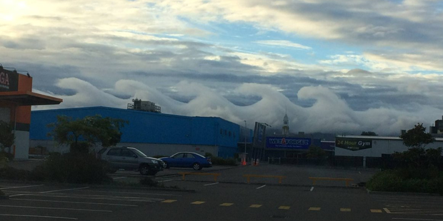
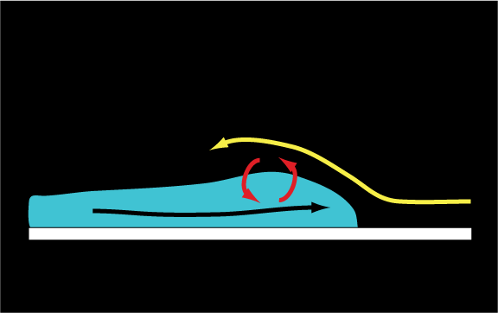
http://www.nzherald.co.nz/nz/news/article.cfm?c_id=1&objectid=11803687
K-H waves:
Shear-driven turbulence
Notes:
Why eddies are important…

Slide 11
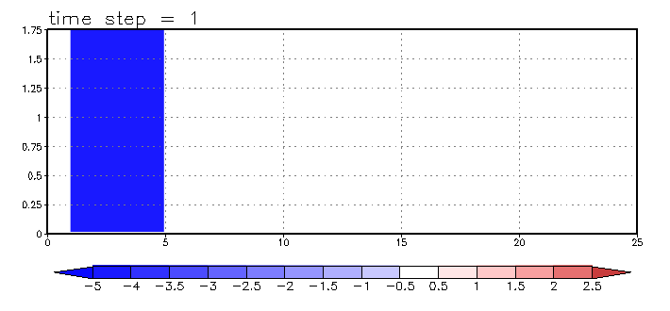
K-H instability
Animation
High-resolution simulation. At lower resolution, you need to parameterize this!
Notes:
Look at the MIXING the eddies accomplish. But you need HIGH RES to capture this effect. At lower res, you need to PARAMETERIZE it

Slide 12
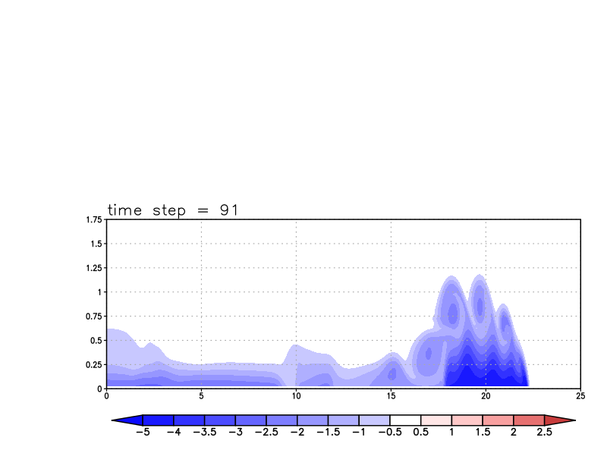
Explicitly resolved eddies, little extra parameterized mixing
∆x = 50 m

Slide 13
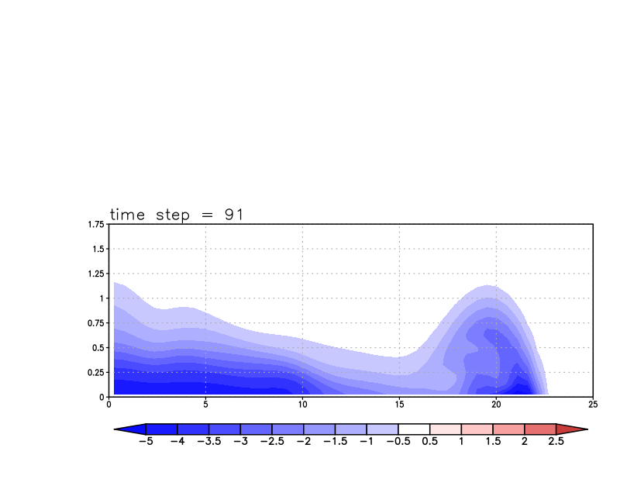
No resolved eddies, considerable parameterized mixing
∆x = 500 m

Slide 14
Review (1)
Eddies are not resolvable but important to the evolution of the PBL
We used Reynolds averaging to identify important eddy covariances such as:
We invoked flux-gradient theory to relate these covariances to eddy mixing coefficients acting on resolved-scale fields

Slide 15
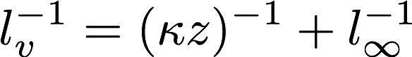
Review (2)
Then we used Prandtl’s mixing length theory to relate K_{m} to mixing length l_{v} and mean (absolute) shear S
Mixing length was presumed to be small near surface and grow (to some upper bound of 50-100 m or so) with height
We also discussed the log wind profile, how it must respond to stability, and saw mixing fields produced by 2 PBL schemes: YSU and MYJ in the in-class demonstration
Now: focus on a scheme that is just based on the equation above (a 1st-order scheme)

Slide 16
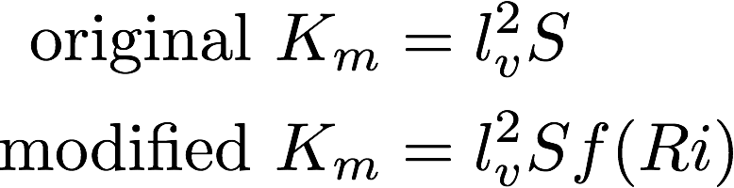
1st-order scheme
Computing K_{m} from a mixing length and the base state vertical shear is called a 1st-order local closure scheme.
“local” because K_{m} only depends on local gradients
In original formulation, K_{m} did not also depend on stability. The modified form modulates mixing by some function of stability: amplifying it when unstable, suppressing it where stable.
Blackadar (1979)
Notes:
The f(Ri) is an improvement, but does not fix the scheme’s systemic problems

Slide 17
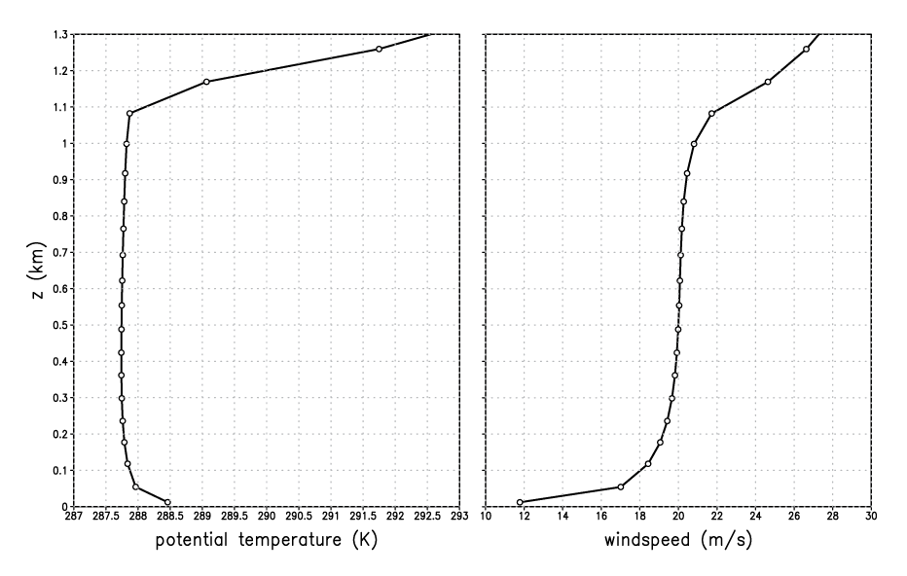
A strongly-heated PBL (simulations with WRF SCM v.3.7.1)
Notes:
Simulated using WRF SCM
This is using a higher wind initial sounding, and lower soil moisture, and that helps exaggerate diff wrt MRF

Slide 18
A strongly-heated PBL
well-mixed
layer
superadiabatic
Notes:
Remember how this was formed. The PBL top inversion is a consequence of the PBL mixing itself

Slide 19
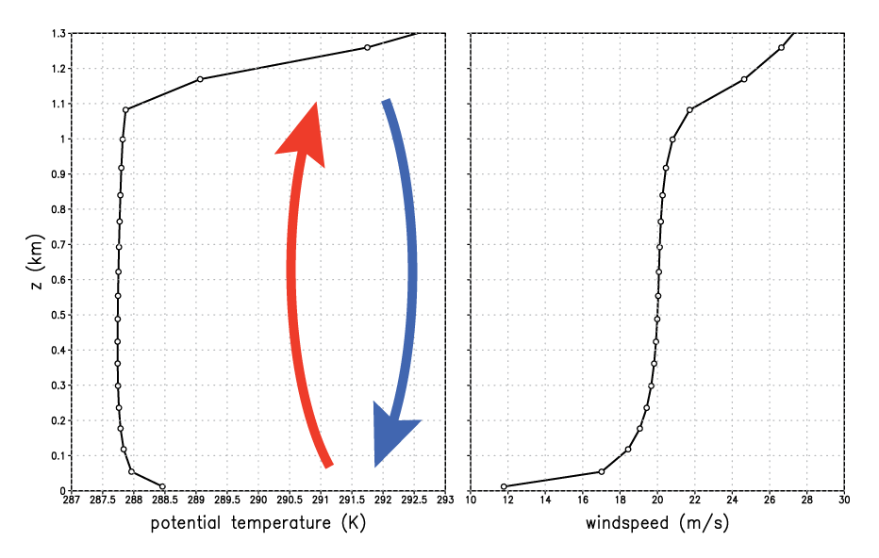
A strongly-heated PBL
well-mixed
layer
superadiabatic
Notes:
Superadiabatic near sfc because mixing restricted near solid boundary. Mixed layer results owing to mixing through a deep layer.

Slide 20
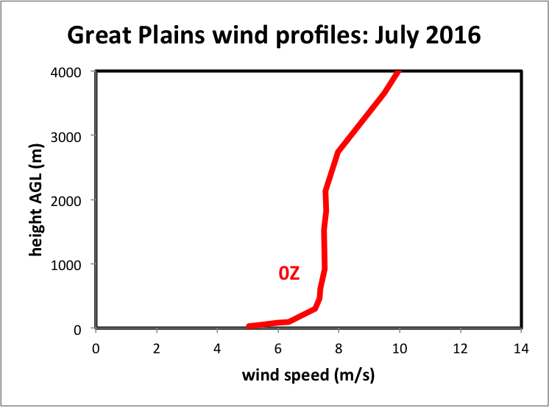
A strongly-heated PBL
11 radiosondes
31 days
well-mixed
layer
superadiabatic
Notes:
Magnitudes, depths different, but shape is similar

Slide 21
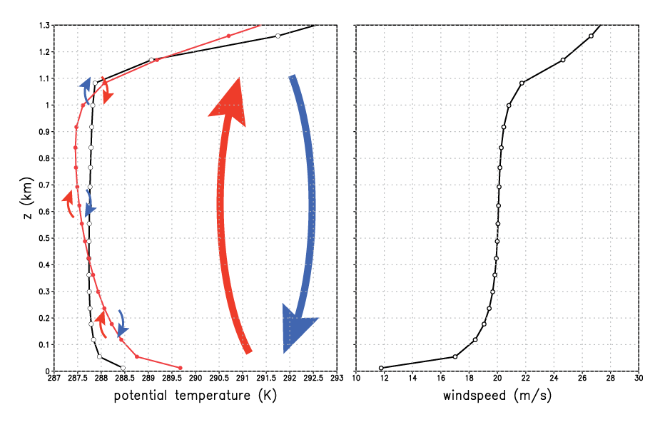
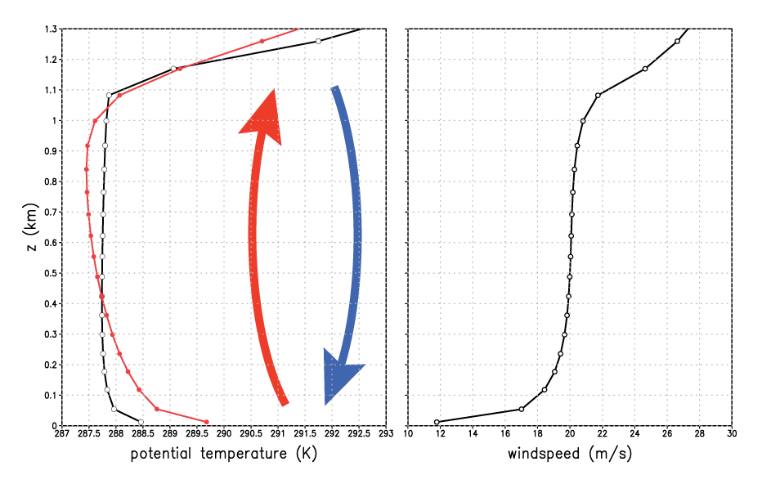
1st-order scheme
well-mixed
layer
First-order scheme’s
local mixing fails to
establish mixed layer
First-order
scheme
superadiabatic
Notes:
First order scheme fails to develop neutral mixed layer. Superadiabatic through a very deep layer.

Slide 22
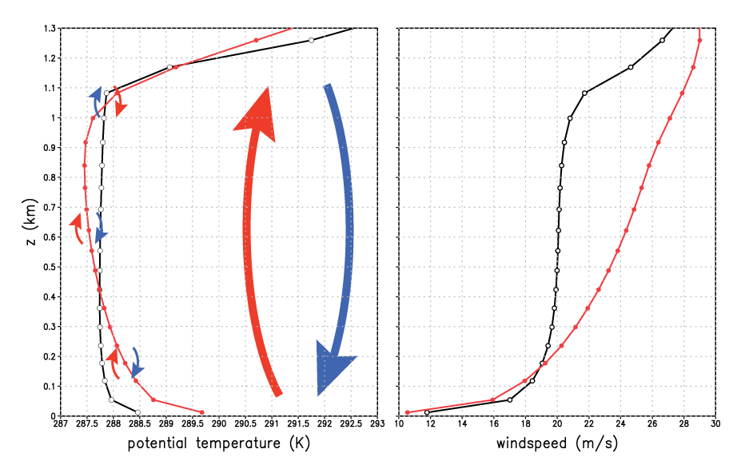
1st-order scheme
Notes:
“For statically unstable ABLs with vigorous convective thermals… wind speed becomes uniform with height a short distance above the ground.” – Stull’s Met for Sci and Eng, p. 81. If shear really disappeared, Km = 0 during time when it actually would be LARGEST. Indeed, shear is very small BECAUSE mixing is so large and effective.

Slide 23
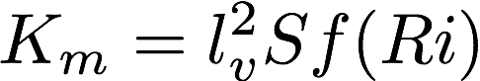
A fundamental inconsistency…
Eddy mixing K_{m} helps remove vertical shear
Thus, as the shear S disappears, K_{m} → 0 in this equation
But, in reality, shear is smallest when mixing is most vigorous!
This model is too simple

Slide 24
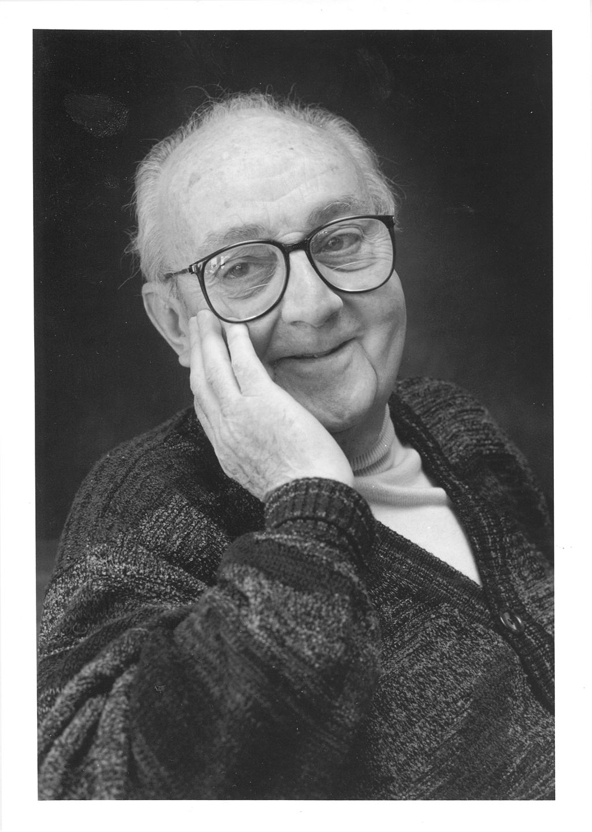
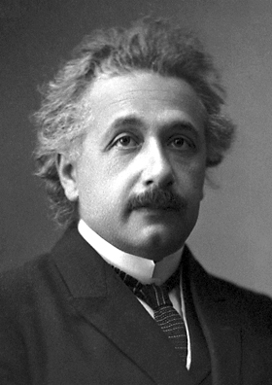
Einstein’s admonition
“Make things as simple as possible,
but no simpler.”
-- Albert Einstein
(1879-1955)
[attributed]
Wikipedia

Slide 25
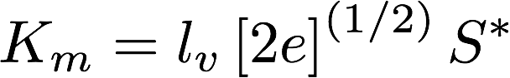
Beyond 1st-order schemes
1.5-order scheme
[based on prognosed TKE e]
[S* is nondimensional
profile function]
KPP (K-profile parameterization)
[diagnosed mixing]
w_{s} = a velocity scale; h = PBL depth
Notes:
Here 2022

Slide 26
A strongly-heated PBL
Produced by
YSU (KPP) scheme
Notes:
Simulated using WRF SCM

Slide 27
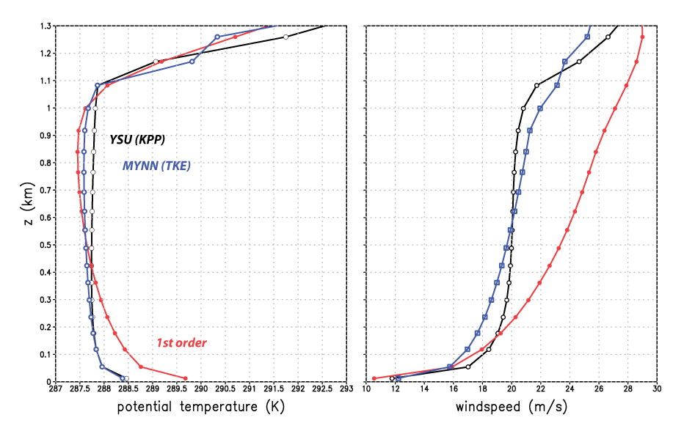
A strongly-heated PBL
(MYNN has changed and added new features since WRF V3.7.1)
YSU and MYNN closer match
(YSU still “better”)
Notes:
Those weren’t obs. They were the YSU solution, presumed to be closest to truth.
MYNN much closer to YSU in surface layer and lower half of mixed layer
(Should say MYNN2)

Slide 28
K-profile parameterizations (KPP)
Including MRF, GFS, YSU, Shin-Hong

Slide 29
KPP scheme lineage
Attempts to specify local mixing (i.e., mixing between neighboring model levels) with a certain and expected vertical distribution
Origins include: Brost and Wyngaard (1978) and Troen and Mahrt (1986)
MRF scheme developed for Medium Range Forecasting (MRF) model: Hong and Pan (1996). Still available in WRF!
MRF/AVN models became GFS in 2002
MRF scheme evolved into GFS and YSU schemes
GFS PBL scheme developed as MRF/AVN models became the GFS and was adopted for Hurricane WRF (HWRF). Continues in current HWRF model as the GFS-EDMF scheme and also in GFS-FV3.
YSU scheme developed for WRF (Noh et al. 2003, Hong et al. 2006, Hong 2010)
Shin-Hong (S-H) scheme evolved from YSU (Shin and Hong 2015)
ACM2 (Pleim 2007) incorporates some aspects of KPP approach
Notes:
Best citation abbreviation ever

Slide 30
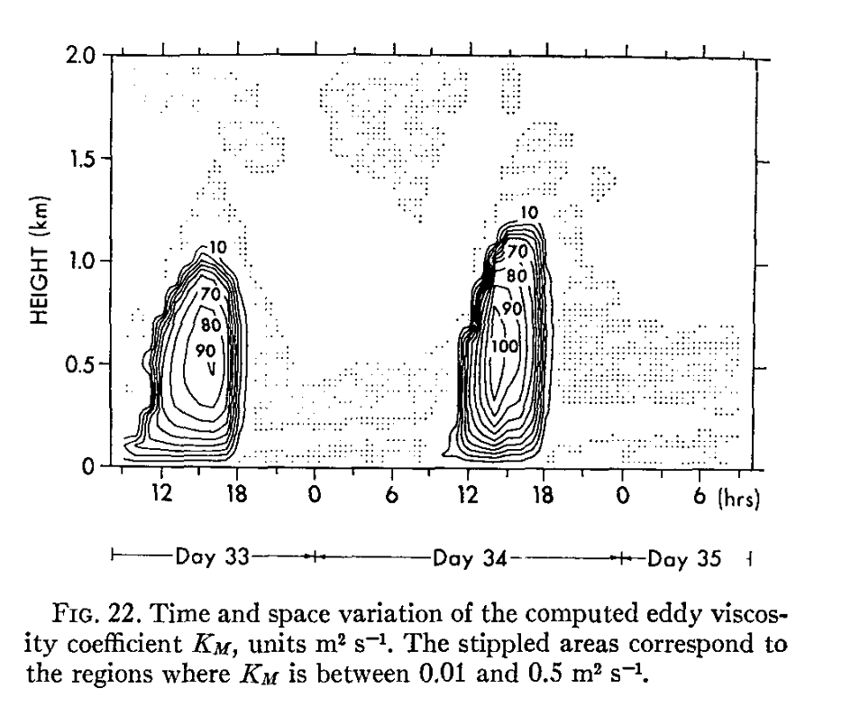
From PBL_Part2.pptx
Mixing produced by a
TKE PBL scheme
Vertical profile at time
of maximum mixing
KPP is trying to forge this
Yamada and Mellor (1975)

Slide 31
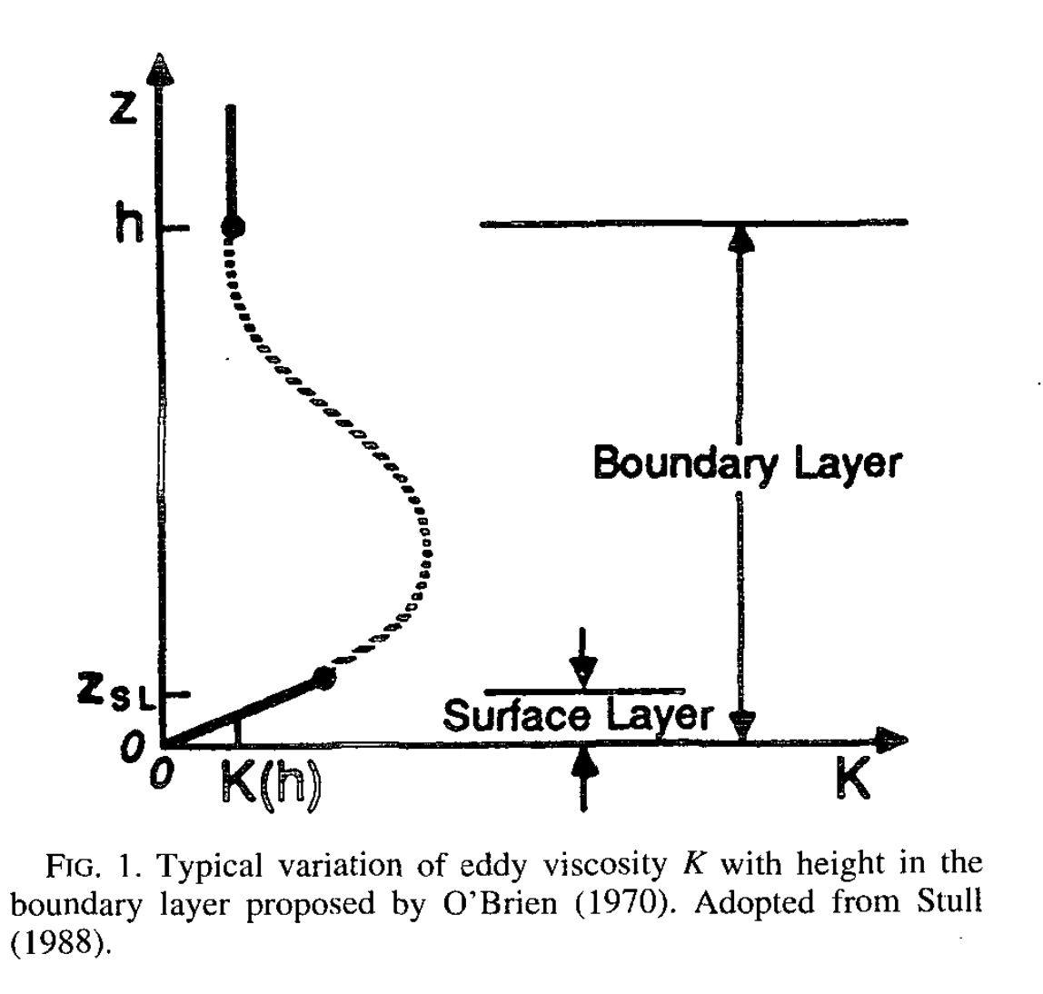
A simple KPP scheme
p = 2 usually adopted
(but Brost and Wyngaard used p = 1.5)
• w_{s} (velocity scale) = u*/φ_{m}
computed in surface layer*
(φ_{m} stability corrector, see Part 1)
• κ = von Karman constant (~0.4)
Tasks:
• Determine PBL depth h
• Fit the profile to K_{m}
MORE
Hong and Pan (1996)
*MRF/GFS velocity scale is constant with height. YSU’s is made a function of height.
Notes:
MRF is simplest version of this approach – the basics
Unstable \phi_m < 1, amping up the velocity scale and thus the mixing

Slide 32
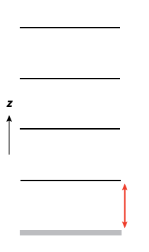
A simple KPP scheme
Finding PBL top h
~ depends on selected critical Ri (Ri_{c})
Compute surface bulk Ri (Rib_{s}) for lowest layer
If Rib_{s} > Ri_{c} then PBL top is reached
model surface

Slide 33
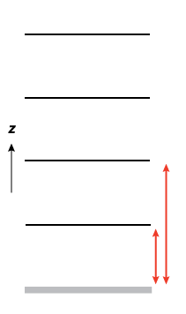
A simple KPP scheme
Finding PBL top h
~ depends on selected critical Ri (Ri_{c})
If not reached, compute Rib_{s}
between surface and next level up,
compare again to Ri_{c}
model surface
Notes:
NOT between layers 1 and 2. Between surface and layer 2.

Slide 34
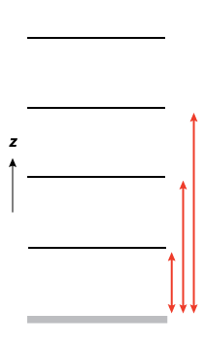
A simple KPP scheme
Keep going until
PBL top is found
Finding PBL top h
~ depends on selected critical Ri (Ri_{c})
h
This is MRF’s PBL height
YSU uses this height as a first guess, and then
factors in a “thermal excess” at surface,
achieving a relatively higher h when PBL unstable
model surface
Notes:
YSU uses this as first guess to PBL depth h. Then, it factors in a “thermal excess” and recomputes h, finding a higher value when PBL is unstable.

Slide 35
A simple KPP scheme
Keep going until
PBL top is found
Finding PBL top h
~ depends on selected critical Ri (Ri_{c})
h
model surface
Notes:
YSU uses this as first guess to PBL depth h. Then, it factors in a “thermal excess” and recomputes h, finding a higher value when PBL is unstable.

Slide 36

K_{m}, K_{h} profile with height
YSU (diagnostic scheme) imposes this profile
based on diagnosed PBL height h
MYJ (prognostic scheme) tries to develop it
organically by predicting TKE
Hong and Pan (1996)

Slide 37
Importance of PBL depth h
In KPP schemes, PBL depth h plays a crucial role, as it directly influences
Mixing depth (obviously),
Mixing magnitude, and
Height of maximum mixing
(located at z = h/3)
Ri_{c} largely determines h

Slide 38
Selecting the critical Ri_{c}
We’re computing a bulk surface Ri, between some level z and the surface
Theoretical value: Ri_{c} = 0.25, but again this also depends on resolution and affected by averaging
Troen and Mahrt (1986) argued for Ri_{c} = 0.5 owing to low vertical resolution in PBL
MRF PBL scheme (Hong and Pan 1996), based on Troen and Mahrt (1986), also used Ri_{c} = 0.5
GFS PBL scheme (descended from MRF) adopted Ri_{c} = 0.25
YSU PBL (also descended from MRF) started with Ri_{c} = 0.5 (Hong et al. 2006). By 2010, it used Ri_{c} = 0.25 when stable, but Ri_{c} = 0 over land when surface layer is unstable (Hong 2010)
The smaller Ri_{c} when unstable was adopted so that the PBL top would be diagnosed below the inversion, permitting explicit treatment of entrainment (see later)
Does this make a difference? (Yes, it can.)
Notes:
Might be OK if Ric didn’t affect the forecasts, but of course it does.

Slide 39
Standard YSU simulation at t = 49 (unstable surface layer)
In this situation, YSU uses Ri_{c} = 0.0 (not 0.25) for its first guess at h
Scheme determines PBL depth ~ 1 km
risfc.gs
Notes:
YSUresults_at_time_49.pdf

Slide 40
risfc.gs
Notes:
When stable, may not matter all that much because mixing produced is so small.
Computed with risfc.gs

Slide 41
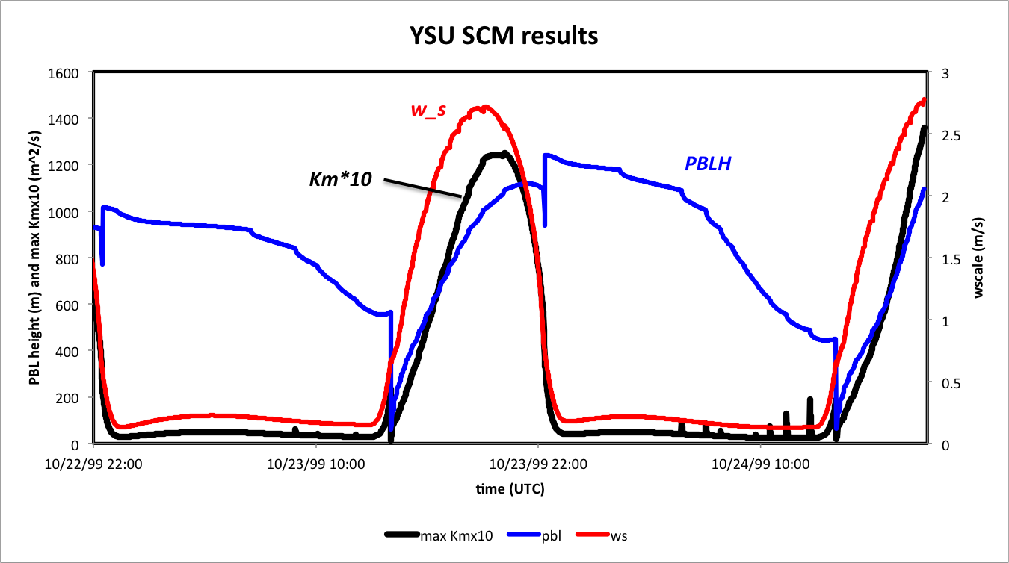
The velocity scale w_{s} also plays a key role, magnifying the mixing when surface
layer is unstable. (This term is more complex in YSU than in sister schemes.)
• Note diurnal variation of K_{m} and w_{s}. Shortly after sunrise, surface layer becomes
unstable, and w_{s} (red curve) increases. At first, PBL depth h (blue curve PBLH)
is shallow, limiting the mixing (black curve).
• Later in the afternoon, surface layer becomes stable, and w_{s} decreases quickly.
Mixing becomes small even though PBLH ostensibly remains deep.
• Note there are discontinuities in PBLH, caused by regime changes between
stable and unstable. (This is seen here because I used output every time step.)
Notes:
Early in afternoon, ws grows quickly but PBLH is shallow, limiting the mixing magnitude and depth
Later, PBLH is deep but ws becomes small as sfc layer goes stable, becoming limiting factor on the mixing

Slide 42
Augmenting local mixing with deep “nonlocal” mixing

Slide 43
Reynolds-averaged θ equation
• K_{m} applies to momentum, K_{h} to heat
• That’s local mixing, between model
levels
Notes:
Apply to theta eq instead. Will explain why – it’s for adding countergrad term, which MRF did not apply to momentum.
One of the neglected RHS terms is diabatic term

Slide 44
Nonlocal mixing term added…
Adds a new term: for nonlocal mixing
Notes:
Apply to theta eq instead. Will explain why – it’s for adding countergrad term, which MRF did not apply to momentum.

Slide 45
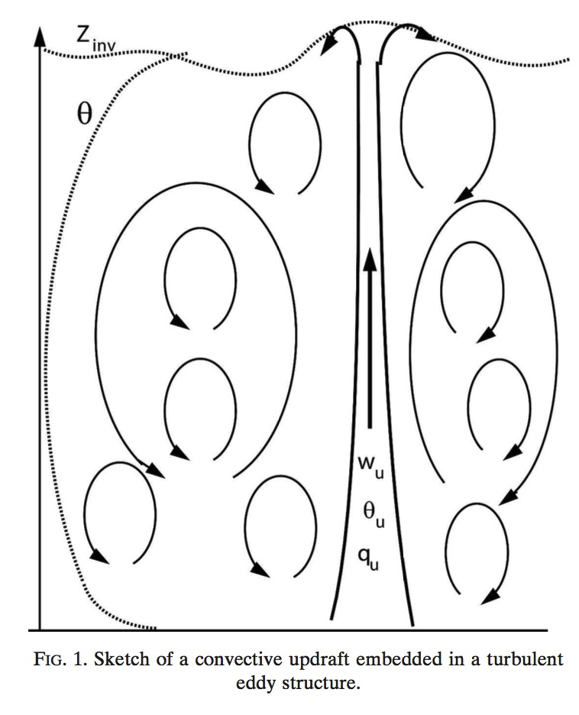
Local vs. nonlocal mixing
Lava lamp
• The K_{m}, K_{h} coefficients are attempting
to accomplish local mixing, as
indicated by the small eddies
• A convective boundary layer also
possesses deep thermals, which helps
make the layer well mixed
• Two approaches for enforcing nonlocal
mixing: the “countergradient” term
and the “mass flux” method
• MRF, YSU use countergradient
approach, forced by surface fluxes
• Mass flux or “EDMF” is a more recent
alternative
(ED = eddy diffusion = K_{m})
Siebesma et al. (2007)
Notes:
Lava lamp

Slide 46
Nonlocal mixing: MRF/YSU “countergradient” term
This accomplishes deep layer
(i.e., nonlocal) mixing
This does local mixing
• Countergradient term is what makes this scheme nonlocal
• Term is generally parameterized based on surface fluxes
to capture effect of deep, penetrating thermals
• In MRF scheme, term applied only to temperature and water vapor
• In YSU, it is also applied to momentum
• This term is what effectively removes mixed layer vertical gradients
Notes:
Although TKE schemes try to do this too, many KPP schemes explicitly account for countergradient diffusion
\gamma_c > 0 for pot temp, increases tendency where dK/dz < 0 (PBL top) and decreases it where dK/dz > 0 (PBL bottom). Helps make less stable

Slide 47
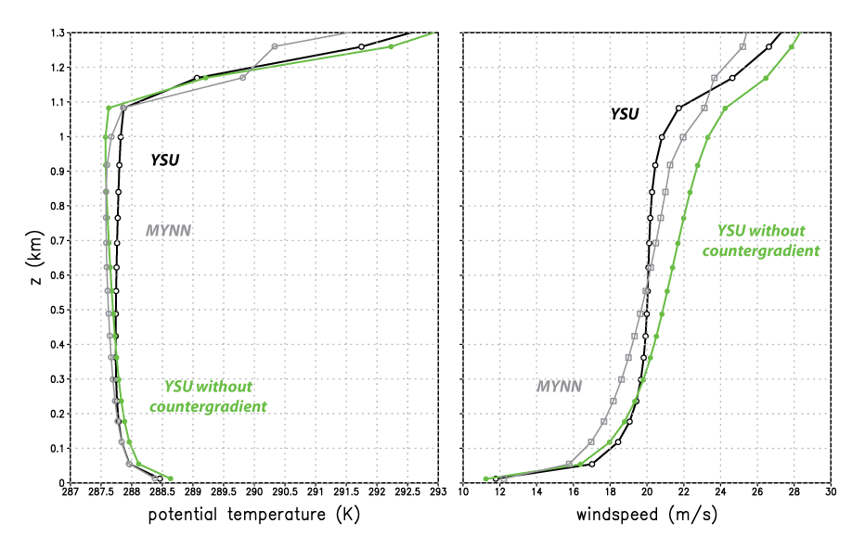
YSU with and without countergradient term
More recent versions
of MYNN have some
nonlocal mixing options
available
Notes:
I added a namelist option to turn off countergradient terms in YSU

Slide 48
Countergradient term history
The need to account for mixing associated with deep thermals to augment local mixing was recognized long ago (e.g., Priestley and Swinbank 1947; Deardorff 1966).
Troen and Mahrt (1986) included the countergradient term in the scheme that gave rise to the MRF, GFS, and YSU schemes.
The MRF and GFS (Hong and Pan 1996) apply the countergradient term to θ and water vapor only.
Starting with Noh et al. (2003), YSU also applied it momentum.
Troen and Mahrt (1986) explicitly excluded momentum from countergradient treatment
Frech and Mahrt (1995), however, showed examples of well-mixed momentum profiles that countergradient momentum mixing can reproduce
Still, Pleim (2007) notes “application of the countergradient term to other quantities has been problematic”.
YSU countergradient term was originally specified in terms of surface fluxes only.
Wilson and Fovell’s (2018) revision to include fluxes at top of boundary layer (ysu_topdown_pblmix = 1) to handle fog cases. (This was a minor factor.)
Clearly, however, this is the term that permits YSU to remove the vertical shear in the mixed layer (last slide).
Notes:
MYNN can do nonlocal momentum mixing but HRRR has not turned it on yet

Slide 49
Aside: mass flux alternative to nonlocal mixing
The Troen-Mahrt approach to nonlocal mixing was (slightly rewritten):
The “mass flux” approach (Siebesma et al. 2007)
Thermal updrafts are presumed to occupy a small area of the grid volume, with fractional area a_{up} << 1.
M is a mass flux = w_{up}a_{up}, where w_{up} is updraft velocity
Can obtain θ_{up} via an entraining plume model (Soares et al. 2004)
Combined with eddy diffusion (ED), approach is called “EDMF”
GFS-EDMF scheme based on GFS recently adopted for HWRF
Notes:
Just the bare bones

Slide 50
Entrainment into PBL
• In addition to nonlocal mixing, air is also
being entrained into the PBL from
the free atmosphere above
• That’s also subgrid, and needs to be
parameterized, and there’s no one
way of doing that
Siebesma et al. (2007)
Notes:
Lava lamp

Slide 51
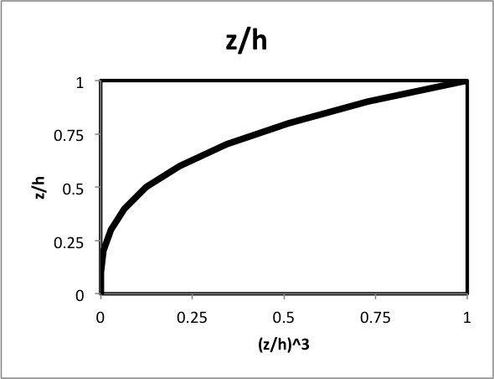
PBL entrainment
Another MRF-YSU difference: YSU explicitly attempts to account for entrainment into the PBL from the free atmosphere.
In the standard version, this term is also parameterized solely in terms of surface fluxes
entrainment term
PBL top flux, but made
inversely proportional
to surface flux
ysu_topdown_pblmix = 1 makes
entrainment a function of PBL top
flux also. This was the key to improved
fog forecasts (Wilson and Fovell 2018).
(z/h)³ function weighted towards
PBL top
Notes:
Got here 2019
Epicycles?

Slide 52
Aside on California fog…

Slide 53
ysu_topdown_pblmix=0
ysu_topdown_pblmix=1
Key difference:
entrainment into PBL
LES = Large Eddy Simulation
Wilson and Fovell (2018)

Slide 54
A quick peek at TKE-based (Mellor-Yamada) schemes
Including MYJ, MYNN2, MYNN3, QNSE, GBM
[WRF’s MYNN: Olson et al. (2019)]

Slide 55
Recall from Part 1…
• Overbars were grid-averaged quantities (what the model is explicitly predicting)
• Primes indicate turbulent variations about those grid-averaged means
• We ignored molecular viscosity as insufficiently large
• We neglected the u’u’ term as small relative to u’w’ term (will reconsider that)
• We then developed a proxy for the u’w’ term based on eddy mixing K_{m}
… but we need to backtrack…

Slide 56
TKE and temperature variance
After defining TKE (velocity variance) as
We saw…
We can also develop a prognostic equation for turbulent temperature variance and …
dissipation/
other terms
related to shear
related to vertical heat flux
Notes:
Not jumping just yet to develop proxies for these eddy covariances

Slide 57
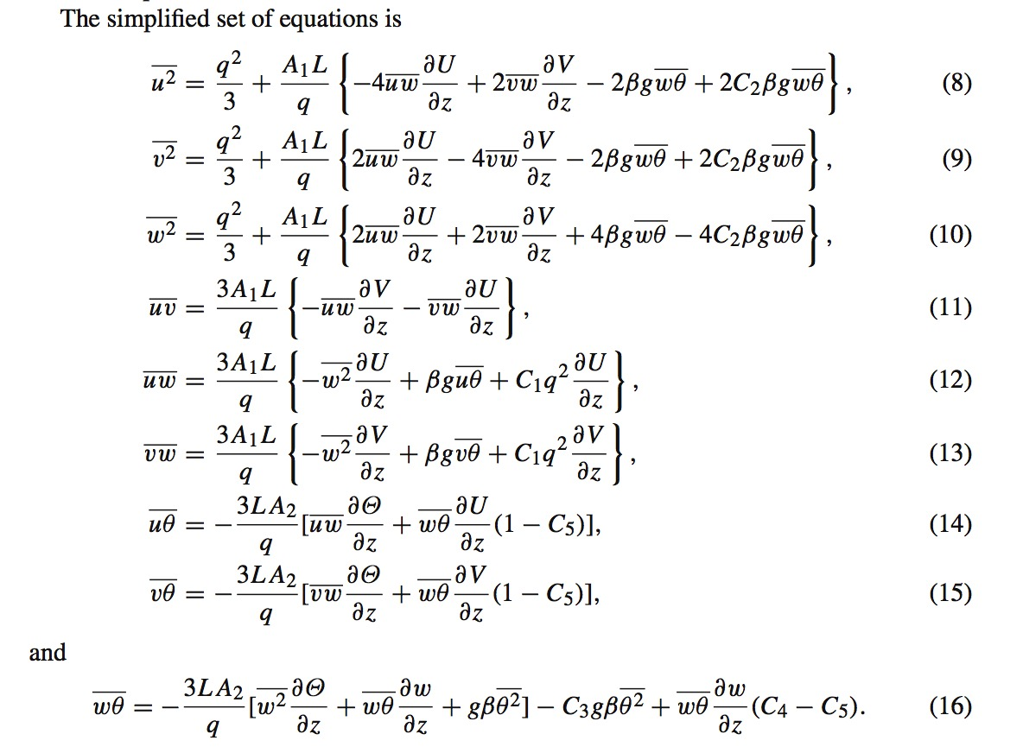
Jahn et al. (2017)
MYNN3 scheme
We wind up with equations for a large set of eddy covariances in the Mellor and
Yamada “Level 3” model, which contain a sizable set of parameters in need of values
[Notation shift… q = TKE (e), and u = u’, etc.]
What sets some TKE schemes apart is which terms retained and parameter values chosen.
MYNN2 is a further simplified version of MYNN3.
Notes:
First eq is \bar{u’u’}. In eq (11), their numbering, term 3 in bracket is essentially our previous simple proxy
A real mess of algebraic manipulation
Actually Jahn et al’s second 2017 paper

Slide 58
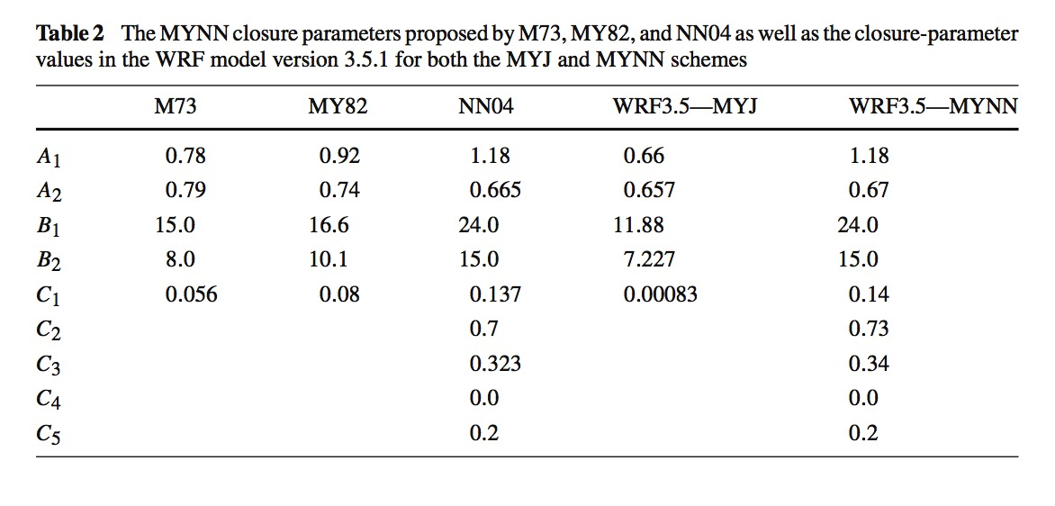
How parameters vary among related schemes
MYJ and MYNN3 in WRF
Jahn et al. (2017)
NOTE: MYNN has changed a lot since WRF V3.5.1
Notes:
Lots of terms means lots of tunable parameters

Slide 59
contaminated
observations
Evaluating HRRR wind speed profiles
near the ground
We also evaluated
temperature profiles
in the PBL
contaminated
observations
Observations from ~60 radiosonde locations
HRRR MYNN2 forecasts at analysis time (00 h forecast)
HRRR MYNN2 forecasts at hours 23 and 24
Fovell and Gallagher (2020)
Notes:
Remind why this stuff can matter

Slide 60
Experiment 1
Using a customized version of the WRFV4.0.3 single column model (SCM)

Slide 61
Setup
Do this IN CLASS
Make sure you are in your lab space’s SCM directory:
cp $LAB/SCM/SETUP.TAR .
tar –xvf SETUP.TAR
Extracts these 6 files: namelist.input, input_sounding, input_soil, force_ideal.nc, control_file, make_all_links.sh
sh make_all_links.sh
You should already have
copied this file
Notes:
Should already have plotsounding.gs, but put in SETUP.tar anyway

Slide 62
namelist.input
...is pre-configured to run 48 h, output hourly, 4 km horizontal column width, 60-sec time step.
In &scm: (things we will NOT change)
scm_force = 0 (advection is switched off)
scm_lu_index = 2 (landuse type is dry cropland; see LANDUSE.TBL under “USGS” section)
scm_isltyp = 4 (soil type is silt loam; see SOILPARM.TBL)
scm_vegfra = 0.5 (vegetation fraction*)
scm_lat and scm_lon are set to a location in Kansas

Slide 63
Modifying namelist.input
In &physics: (default setup)
sf_sfclay_physics = 1, (standard surface layer)
sf_surface_physics = 2, (Noah land surface model, or LSM. Don’t change for this experiment.)
bl_pbl_physics = 1, (YSU PBL scheme)
bldt = 0, (time step for PBL; do not change)
bl_mynn_mixlength = 2, (MYNN; don’t change )
bl_mynn_edmf = 1, (MYNN option; don’t change)
MYNN2’s non-local mixing

Slide 64
PBL and surface layer schemes
PBL and surface layer (not LSM) schemes are often paired. Some combinations are optimized, and others do not work. [Leave sf_surface_physics unchanged at 2 (Noah LSM).]
bl_pbl_physics (incomplete list) | Scheme name | sf_sfclay_physics (bold = use for this exp.) | K_{m} | K_{h}
1 | YSU (KPP) | 1, 91 | dku3d | dkt3d
2 | MYJ (TKE) | 2 | -- | exch_h
4 | QNSE (TKE) | 4 | exch_m | exch_h
5 | MYNN2 (TKE) | 1, 2, 5, 91 | exch_m | exch_h
6 | MYNN3 (TKE) | 1, 2, 5, 91 | exch_m | exch_h
7 | ACM2 (KPP) | 1, 7, 91 | -- | exch_h
11 | Shin-Hong (KPP) | 1, 91 | -- | exch_h
99 | MRF (KPP) | 1, 91 | dku3d | dkt3d
Notes:
Here 2022

Slide 65
Experiment 1 goals
EXPERIMENT #1 DUE MARCH 24, AT START OF CLASS
Part 1: demonstrate vertical profile of horizontal wind speed and how it varies with time of day
Part 2: demonstrate variation in afternoon boundary layer structure among various parameterizations
Although not explicitly demonstrated in this experiment, a sizable part of this variability comes from the surface layer parameterization, which can then be magnified by different PBL assumptions and approaches

Slide 66
Experiment 1 (Part 1)
Do this OUTSIDE OF CLASS
Part 1: No new simulation necessary
You already have output from a 48 h simulation with YSU (bl_pbl_physics = 1, sf_sfclay_physics = 1) called pbl_ysu. This is the control run.
This used w2g with control_file to create GrADS files interpolated to geometric height coordinates
Write a GrADS script to plot wind speed vs. ln(z) at three times during the simulation: t = 37, 44, and 49. (Like plot on slide 48 of PBL_Part1.pptx; also see next 2 slides.)
Restrict the plot to the lowest 8 model levels (set z 1 8).
For each time, normalize the wind speed by the value at the lowest model level.
Label the plot axes and put your last name in the plot title.
See tips on slide 69.
Make a PNG image of this plot and email it to Richard and I. Name the file using your last name (i.e., lastname_image.png). Also email us your GrADS script.
Notes:
Set t 44 intentional, tho not equall spaced, since t=43 is at sunrise and too similar to overnight (t = 37)
T=44 is 1 hr after sunrise

Slide 67
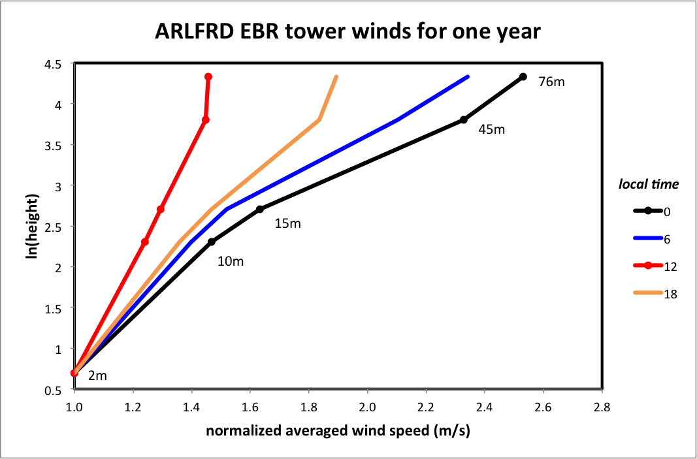
For your plot, the wind speeds will be for model levels 1-8
and normalized by wind speed at model level 1 (~ 27 m) instead
1200
local noon
0000
local midnight
Slide 48 from PBL_Part1.pptx
(not a WRF simulation)
Normalized winds plotted against log height.
Normalization by wind speed at 2 m.
Less shear at 1200 local and more at 0000 local.
We will utilize this information to predict winds near the surface
Notes:
Plotted against ln(z). Straight lines expected and roughly obtained. Shear larger when more stable.

Slide 68
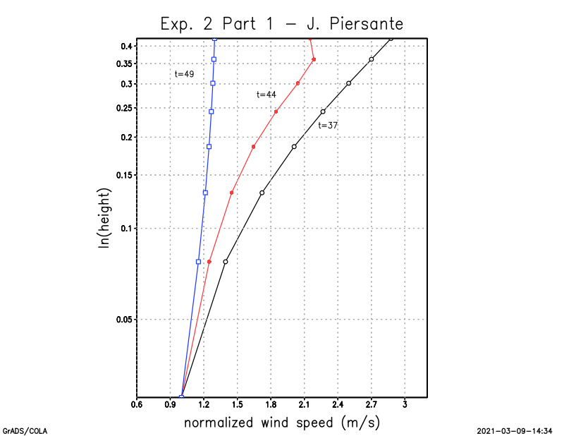
What Part 1 plot might look like

Slide 69
Tips for Part 1
Remember: set display white makes the background white (or execute white.gs)
To plot against ln(z): set zlog on. (To revert to linear height: set zlog off.)
Use defined variables to normalize the wind profiles. Example:
set t 37
set z 1
define swind=mag(u,v)
set z 1 8
d mag(u,v)/swind
This normalizes the wind at levels
z=1,8 by the wind speed at z=1
Do this separately for each time needed

Slide 70
Experiment 1 (Part 2)
Do this OUTSIDE OF CLASS
Make new 48 h simulations with the MRF, QNSE, and MYNN2 schemes. See slide 64. Leave sf_surface_physics unchanged at 2 (Noah LSM).
For MRF, you are still using sf_sfclay_physics = 1
For QNSE, use
sf_sfclay_physics = 4, bl_pbl_physics = 4
For MYNN2 run (HRRR-like configuration) use
sf_sfclay_physics = 5, bl_pbl_physics = 5, bl_mynn_mixlength = 2 and bl_mynn_edmf = 1
Remember to srun –p snow ideal.exe after modifying namelist.input!
Use w2g with control_file to create GrADS files interpolated to geometric height. GrADS filenames like pbl_mrf are appropriate.
Notes:
They should find the results of the t=49 theta vs. z plot distressing. Too much variation given a single initial condition and, ultimately, only one correct answer.
Later, use these created files for another in-class demo

Slide 71
Experiment 1 (Part 2 cont.)
Open YSU, MYJ, and your three new files and make the following separate plots. All plots are for time 49, and for the 0-2 km height range. All plots superimpose all 5 simulations. Make sure your axis ranges are reasonable (See next slide for tips):
Plot theta vs. linear z superimposing all 5 theta profiles. Label axes and make a PNG file. Make a filename including your last name.
Plot windspeed vs. linear z for the 5 profiles. Label axes and make a PNG file, again using a naming scheme involving your last name.
Plot qvapor vs linear z for the 5 profiles. Label axes and make a PNG file, again using a naming scheme involving your last name.
Think about the variability you are seeing. In real life, there’s only one correct answer. In the idealized world, while there’s no correct answer, if one of these is right, the others have to be wrong.
[For Experiment 1, you are sending us a total of 4 image files, and one GrADS script]

Slide 72
Tips for Part 2
To zoom into the lowest 2 km, use
set lev 0 2
Wind speed is mag(u,v)
To plot profiles from various open files:
d theta.1
d theta.2
d theta.3 [etc.]
d mag(u.1,v.1)
d mag(u.2,v.2) [etc.]
Once you know what a reasonable range for the x-axis should be, specify it using the vrange command.
Example: set vrange 0 100

Slide 73
Extra info #1
I showed previously how surface roughnesses were defined in LANDUSE.TBL. When the Noah LSM is used, however, those are overridden by values defined in VEGPARM.TBL.
Roughness values are saved in wrfout files as both Z0 and ZNT.
In VEGPARM.TBL, landuse categories are assigned max and min roughness values, Z0MAX and Z0MIN. The Noah LSM (sf_surface_physics=2) imposes a seasonal cycle* with these values as bounds, and does this during the first time step (after 1st wrfout write).
As a consequence, Z0 & ZNT values written to wrfout for the first time step (at model start) are likely to be incorrect
*See, for example, Fig. 8 of Cao and Fovell (2018)

Slide 74
Extra info #2
Example: namelist.input specifies scm_lu_index = 2 and start date as October 22nd
Note: start date cannot be easily changed
VEGPARM.TBL defines landuse category 2 as “Dryland Cropland and Pasture” with Z0MIN = 0.05 and Z0MAX = 0.15 (both are meters in this file)
ncdump –v ZNT wrfout_d01_1999-10-22_19:00:00 reveals ZNT is 0.05 at first history time, but 0.15 thereafter. Z0/ZNT was revised based on the model start date, but not until after the first (wrong) value was written out to wrfout.
Notes:
Two values appear for each time because west_east = 2, and two lines for each time since south_north=2

Slide 75
Extra info #3
You can run WRF with a land surface model and a surface layer scheme, but without a PBL (set bl_pbl_physics = 0). What happens? What did you expect to happen?

